Slide 1
SalesGenie – AI Powered sales assistant
Capstone Project
By Sreedevi balaji

Slide 2
SalesGenie — business context, problem & solution
Capstone project · Oak & Ember Interiors, a fictional nationwide furniture retailer
Business context
Problem statement
Proposed solution
Oak & Ember Interiors — fictional nationwide furniture retailer
20 sales reps, each handling ~15 inbound leads per day
Leads arrive by email and are triaged manually today
As-is CRM is effectively an Excel sheet, updated by hand
Capstone scope: Sales Representative is the sole primary persona
Manual triage, qualification and drafting don't scale with lead volume
Inconsistent qualification risks losing high-value leads
Reps spend time on repetitive admin instead of selling
Slower responses reduce the odds of converting a lead
No structured visibility into how leads are actually handled
SalesGenie: a multi-agent AI pipeline built in n8n
Sequential flow: ingest → qualify → recommend → draft reply
CRM update runs in parallel; weekly insights on its own cadence
Grounding rules and evaluation built in from day one
Langfuse tracing gives full observability across every run
Human review stays in the loop for customer-facing replies at launch
Weekly Insight Report Generator

Slide 3
SalesGenie — Proposed Architecture
Complete architecture • Production + Evaluation • Input → Processing → Output
Workflow 1
New lead email
Trigger node
Email ingestion agent
Parses lead email
Workflow 2
Lead qualifier agent
Scores lead quality
Product Recommender agent
Recommends Product Catalog
Generate CRM records from workflow 1
Trigger node
Response Drafter Agent
Generate Email
CRM auto-update
Exports CSV batch
Weekly insights
Summary report
Langfuse tracing
Shared trace ID across every agent

Slide 4
SalesGenie — Architecture Decision Record
Complete architecture • Production + Evaluation • Input → Processing → Output
# | Agent | Role | Responsibility
1 | Email Ingestion Agent | Inquiry Understanding & Extraction | Parses raw inquiry emails and extracts of customer name, email, product interest, budget and other relevant information present in the inquiry.
2 | Lead Qualifier Agent | Lead Qualification & Prioritization | Evaluates extracted customer signals and classifies leads as Hot, Warm or Cold using defined qualification criteria.
3 | Product Recommender Agent | Catalogue-Based Product Matching | Matches customer requirements to relevant Oak & Ember catalogue items and provides a recommendation rationale grounded in catalogue data.
4 | Response Drafter Agent | Personalized Customer Communication | Generates a personalized customer response using the qualified lead information and grounded product recommendations.
5 | CRM Update Agent | CRM Data Structuring & Update | Converts qualified lead information into a standardized CRM-ready CSV for downstream CRM import, while preserving data accuracy and required field mappings.
6 | Weekly Sales Insight Agent | Sales Reporting & Insights | Aggregates processed leads and produces a structured weekly sales report containing metrics, lead distribution, product trends and other supported insights.
The proposed architecture uses multiple specialized agents coordinated by an Orchestrator, with each agent responsible for a clearly defined business capability and structured input/output contract.
The architecture includes six specialized agents:
The Orchestrator manages the sequence and controls how outputs move between agents.

Slide 5
SalesGenie — Agent with Input and Output
Complete architecture • Production + Evaluation • Input → Processing → Output
Agent | Role | Input | Output
Email Ingestion Agent | Inquiry understanding and extraction | Raw inbound email | Structured inquiry
Lead Qualifier Agent | Lead qualification and prioritization | Structured inquiry | Hot/Warm/Cold classification
Product Recommender Agent | Catalogue-based product matching | Qualified lead + product catalogue | Product recommendations + rationale
Response Drafter Agent | Personalized customer communication | Qualified lead + recommendations | Customer response draft
CRM Update Agent | CRM data structuring and update | Qualified lead | CRM-ready CSV
Weekly Sales Insight Agent | Sales reporting and insights | Processed lead data | Weekly sales report

Slide 6
SalesGenie — Why Multi-Agent Instead of a Single Agent?
A single LLM agent could theoretically perform all SalesGenie capabilities. However, a multi-agent architecture was selected because the capabilities have different responsibilities, data sources, grounding requirements and failure modes.
The multi-agent design therefore provides a better structure for evaluating and improving AI behavior at each stage, which is particularly important for SalesGenie's catalogue-grounding, lead-classification and CRM-data-accuracy requirements.
Consideration | Multi-Agent Approach
Responsibility | Each agent has a focused business capability
Grounding | Agents can use the appropriate source of truth
Evaluation | Each capability can have its own evaluation metrics and ground truth
Failure isolation | Errors can be traced to a specific processing stage
Guardrails | Controls can be defined for individual capabilities
Observability | Individual agent execution can be traced
Experimentation | A single agent can be modified without changing the entire workflow
Maintainability | New capabilities can be added without continually expanding one large prompt

Slide 7
SalesGenie — Workflow 1 lead processing
Complete architecture · Production + evaluation · Input → agent → output
New lead email
Trigger node
Input
Raw inbound email
→
Email ingestion agent
Parses lead email
→
Output
Structured inquiry — name, email, interest
Input
Structured inquiry
→
Lead qualifier agent
Scores lead quality
→
Output
Hot / warm / cold classification
Input
Qualified lead + catalogue
→
Product recommender agent
Matches products from catalogue
→
Output
Recommendations + rationale
Input
Qualified lead + recommendations
→
Response drafter agent
Drafts personalized reply
→
Output
Draft — sent for rep review
Parallel branch — runs off lead qualifier output
Input
Qualified lead
→
Parallel
CRM update agent
Structures data for CRM
→
Output
CRM-ready CSV — daily batch
Langfuse tracing
Shared trace ID across every agent — every run, every stage
Evaluation : n8n Evals
Evaluation across every agent — every run, every stage

Slide 8
SalesGenie — Weekly Sales Insights
Complete architecture • Production + Evaluation • Input → Processing → Output
PRODUCTION INPUT
EVALUATION INPUT
Google Sheets — CRM
Custom Evaluation Dataset
All processed leads • created_at • tier • product • budget • status • urgency • customer data
test_id • test_name / scenario • expected metrics • one dataset row drives one evaluation run
WEEKLY INSIGHT GENERATION & EVALUATION
1
2
3
4
5
6
7
8
START NODE
Get CRM Data
Filter Weekly Records
Aggregate Metrics
Weekly Sales Insight Agent
LLM as Judge
Set Metrics
Final Result
Two Execution Nodes
EXECUTE WORKFLOW(Trigger Weekly)
EVALS – Fetching a dataset
PASS / FAIL
Score per testcase
Evaluation Matrix
Input: Output
CRM from workflow1
Output: CRM records
Input: filtered records
Output: lead counts, products,
opportunities, data quality
Input: aggregated metrics
Output: weekly sales
insights report
Input: source metrics + AI report
Output: groundedness,
insight, trend, hallucination
Input: judge JSON
Output: evaluation metrics
Input: records + scope
Output: weekly records
ONE ROW → ONE RUN
AI OUTPUT
JUDGE OUTPUT
OBSERVABILITY
Weekly Sales Insights Report
Structured Evaluation JSON
Evaluation Matrix + Trace
Executive summary • lead/product observations
High-value opportunities • follow-up priorities • actions
Groundedness • Insight Quality • Trend Quality
Overall Score • Hallucination YES/NO • PASS/FAIL
Per-testcase scores recorded in n8n
Trace: input → aggregation → agent → judge → metrics
Each evaluation dataset row → one workflow execution → one report → one judge result → one Evaluation Matrix result

Slide 9
SalesGenie — Tools and Technologize Used
Tools and Technologies Category | What You Need | Examples (not exhaustive)
Workflow/Agent Platform | Low-code or no-code platform | n8n
LLM | Reasoning, classification, generation | OpenAI gpt-4o-mini
Data Ingestion | Read/parse emails, CSVs used pinecone | Built-in nodes, HTTP Request, code
Observability | Monitor traces, track quality | Langfuse
Output/Integration | Google sheet, email, reporting | Google Sheets, CSV , Vector DB
Evaluation | Run → Score → Learn → Change → Re-score | N8N evaluation trace and metrics

Slide 10
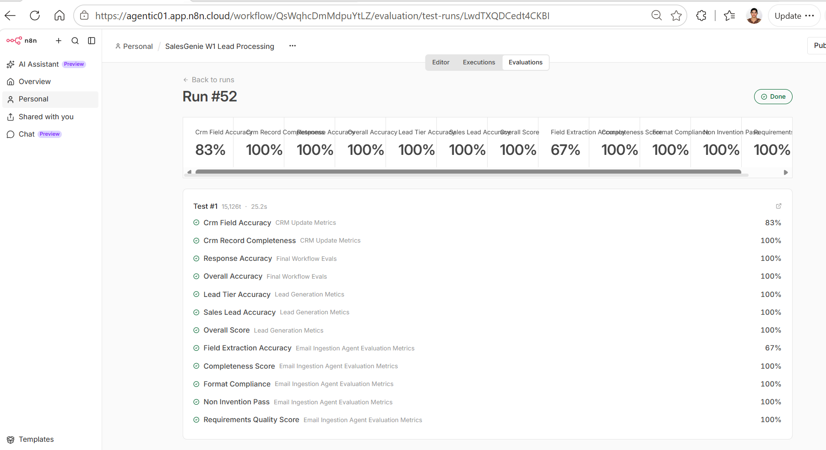
SalesGenie — Workflow 1 Evaluation
Using n8n evaluation used code-based validation + LLM as Judge for evaluation

Slide 11
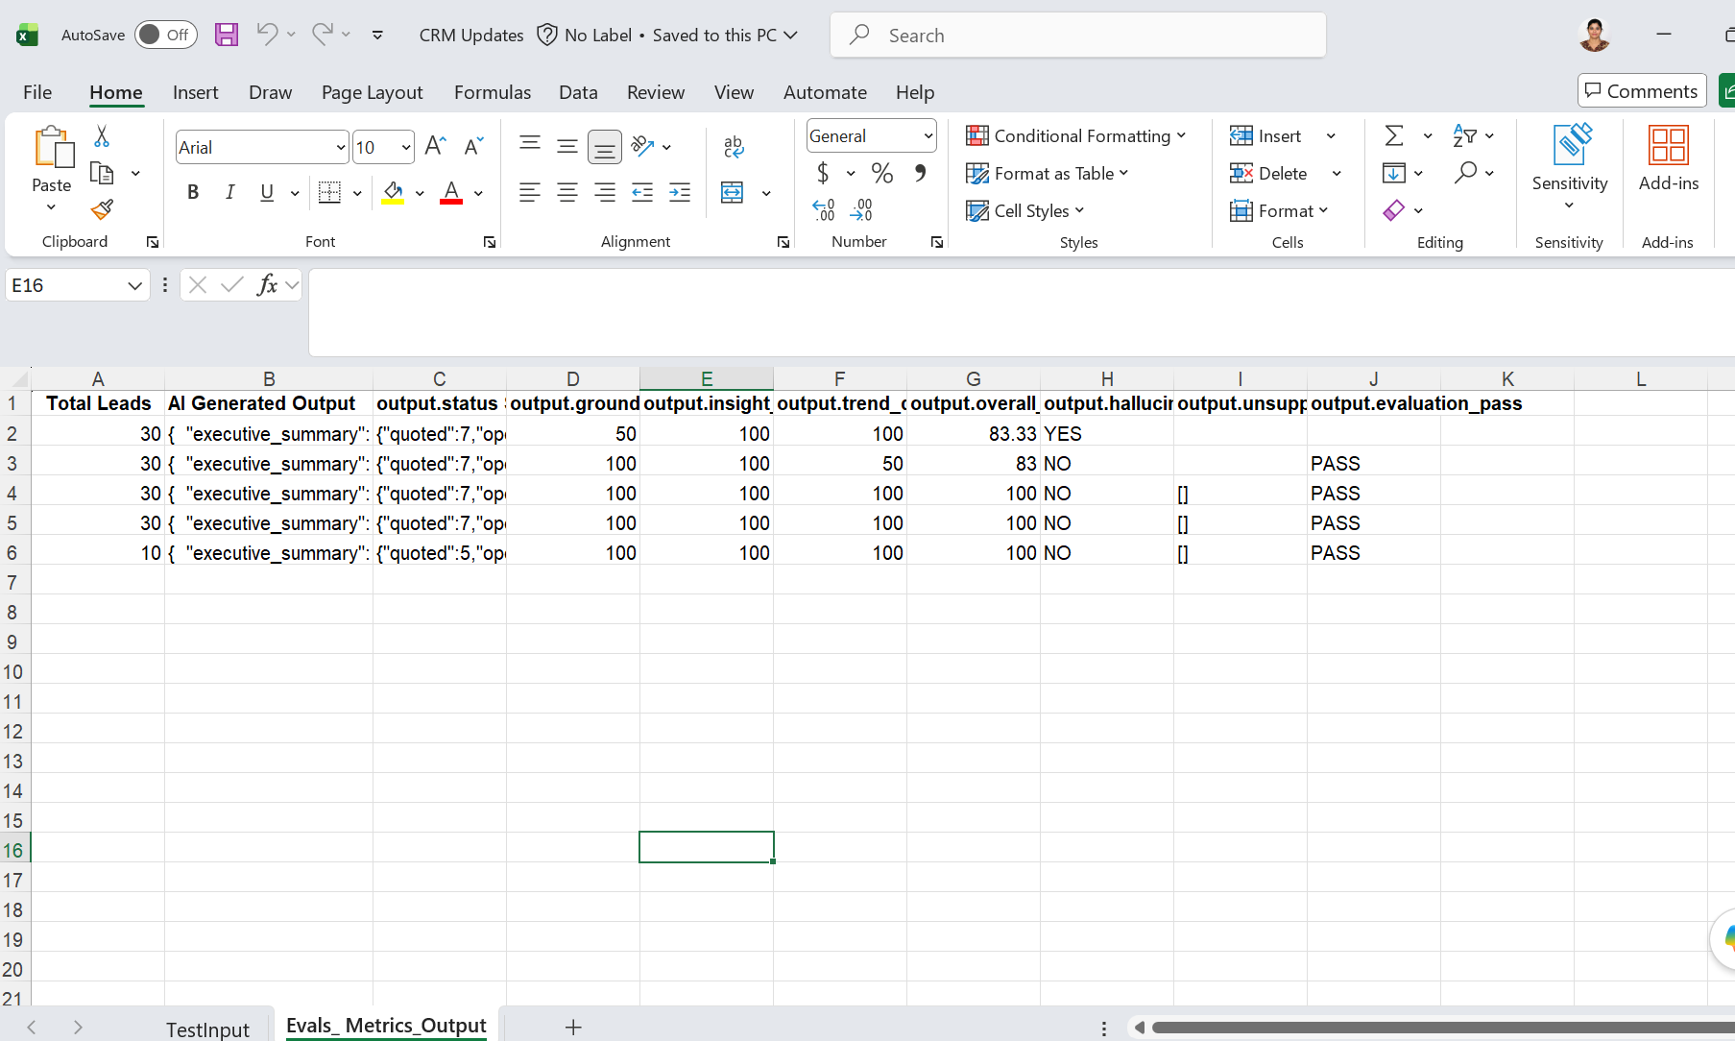
SalesGenie — Workflow 2 Evaluation
Using n8n evaluation used code-based validation + LLM as Judge for evaluation

Slide 12
SalesGenie — Business Outcome
From Manual Lead Handling → Intelligent, Measurable Sales Operations
SalesGenie delivers business value across the entire lead lifecycle:
Save Time - Reduce the 2–3 hours/day reps spend on manual email processing, qualification and CRM entry.
Improve Sales Effectiveness - Consistent lead qualification + catalog-grounded recommendations help reps focus on the highest-priority opportunities.
Improve Data Quality - Automated extraction and CRM structuring reduce missing fields, manual errors and inconsistent records.
Accelerate Follow-up- Faster response drafting and CRM updates enable reps to act on qualified leads sooner.
Enable Data-Driven Decisions- Weekly AI insights turn CRM data into grounded, actionable sales intelligence.
Business Impact
Less administrative work → Better data → Faster action → More productive sales teams

